Slide 2
HIV and Diabetes:
The Care Continuum of a Co-epidemic
Jonathan Colasanti MD, MSPH
Division Infectious Diseases, Emory University SOM
Infectious Disease Program, Grady Health System
Atlanta, Georgia
@jcolasantimd
Share your thoughts on this presentation with #IAS2019

Slide 3
Disclosures
CME with Integritas Communications, LLC (through unrestricted educational grant, Gilead Sciences)
Consulting with Abt Associates (HRSA project)
No Conflicts of Interest

Slide 4
Outline
Epidemiology
Pathophysiology
Screening, Diagnosis & Prevention
Management & Implementation

Slide 5
Epidemiology
&
Pathophysiology

Slide 6
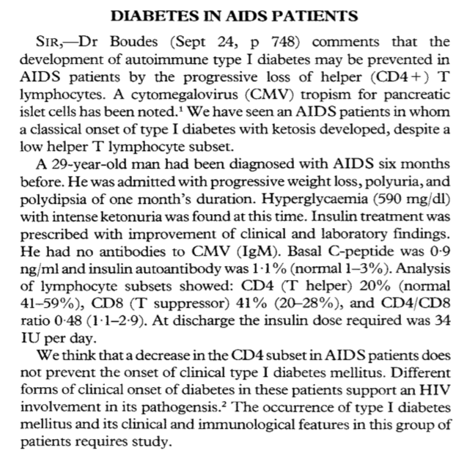
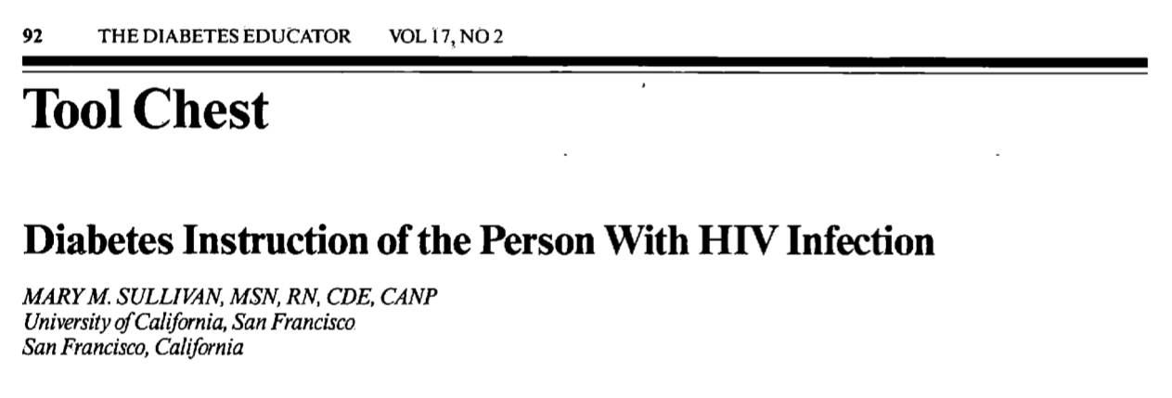

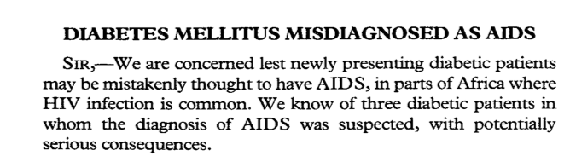
HIV and Diabetes: Partners from the Beginning
Vendrell J et al Lancet 1988
Andrews et al Lancet 1989
Sullivan The Diabetes Educator 1991

Slide 7
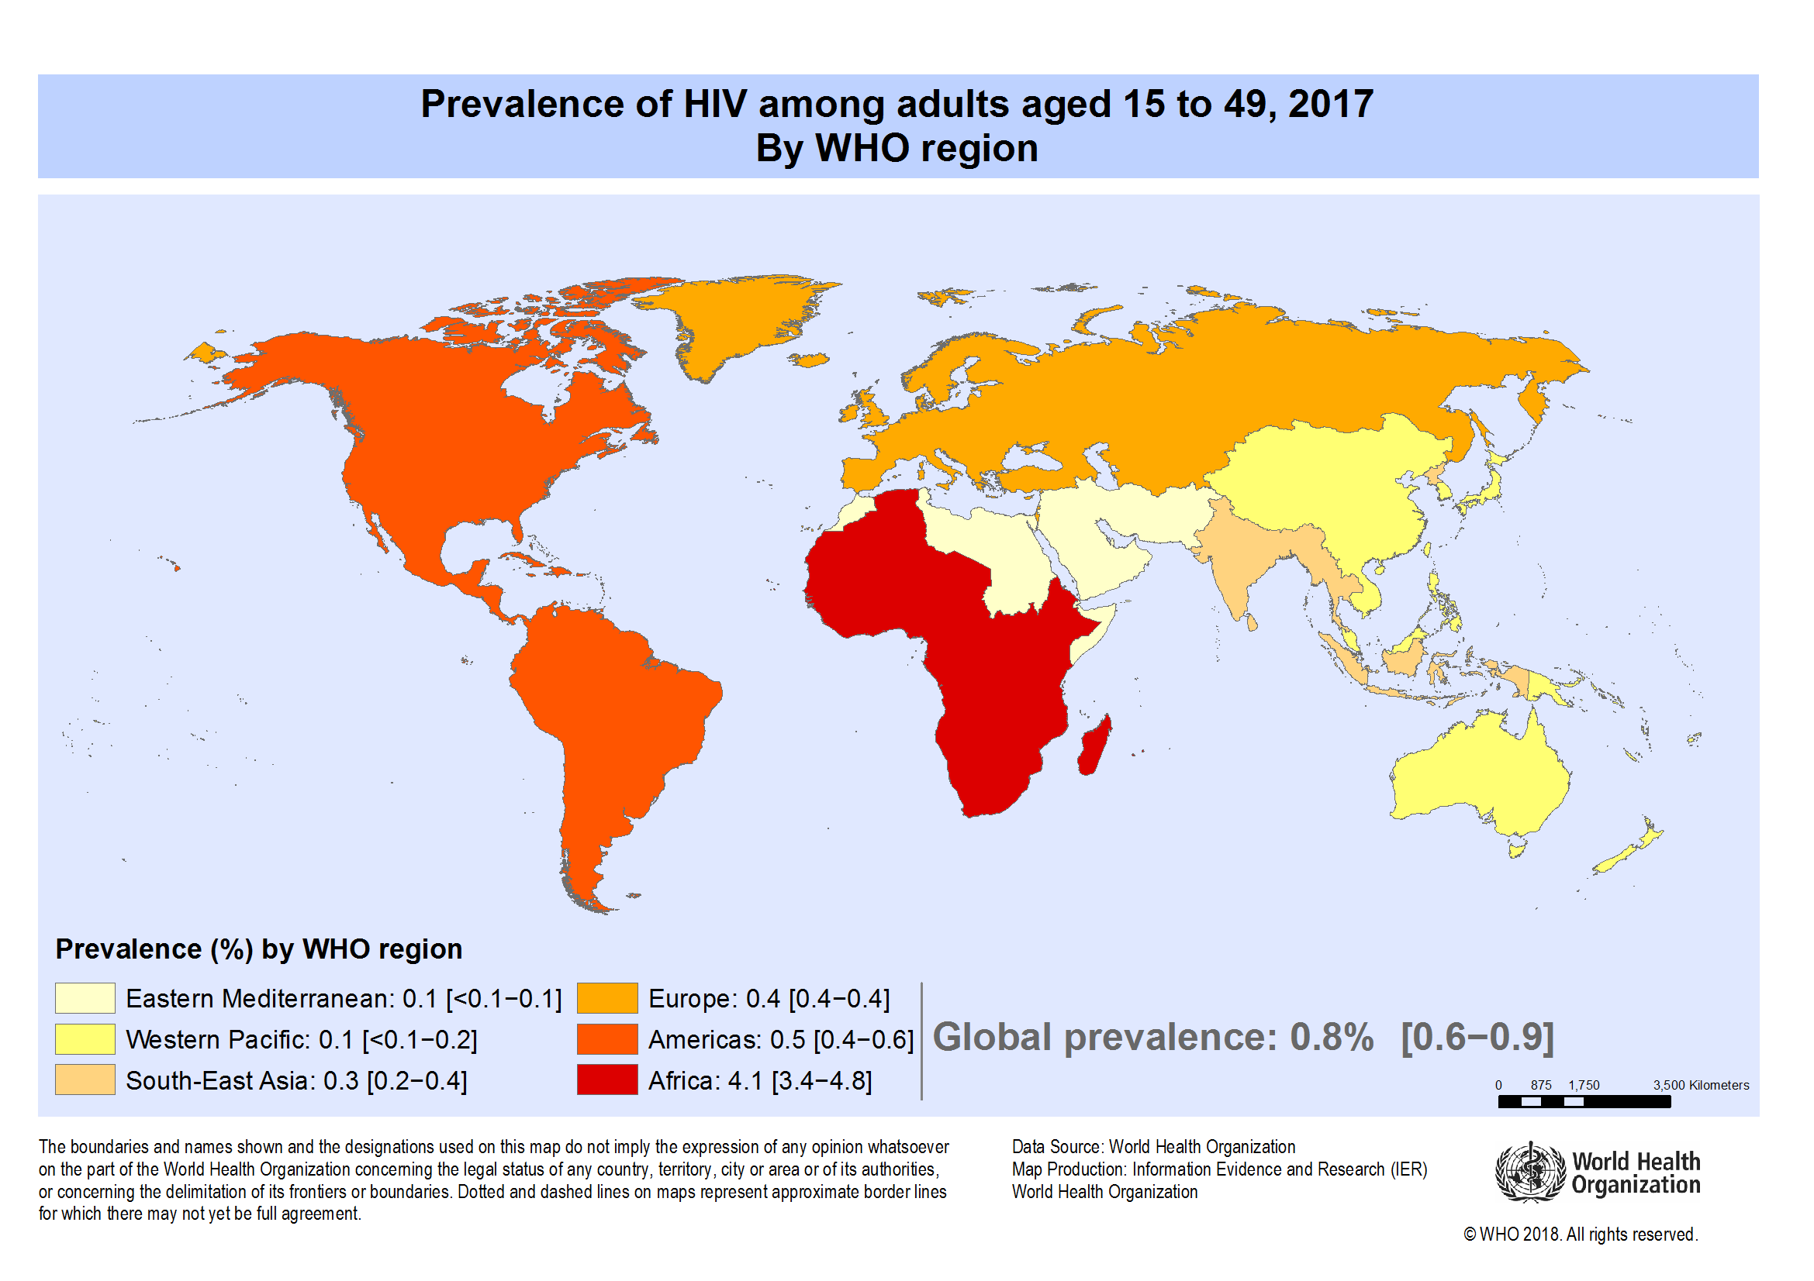
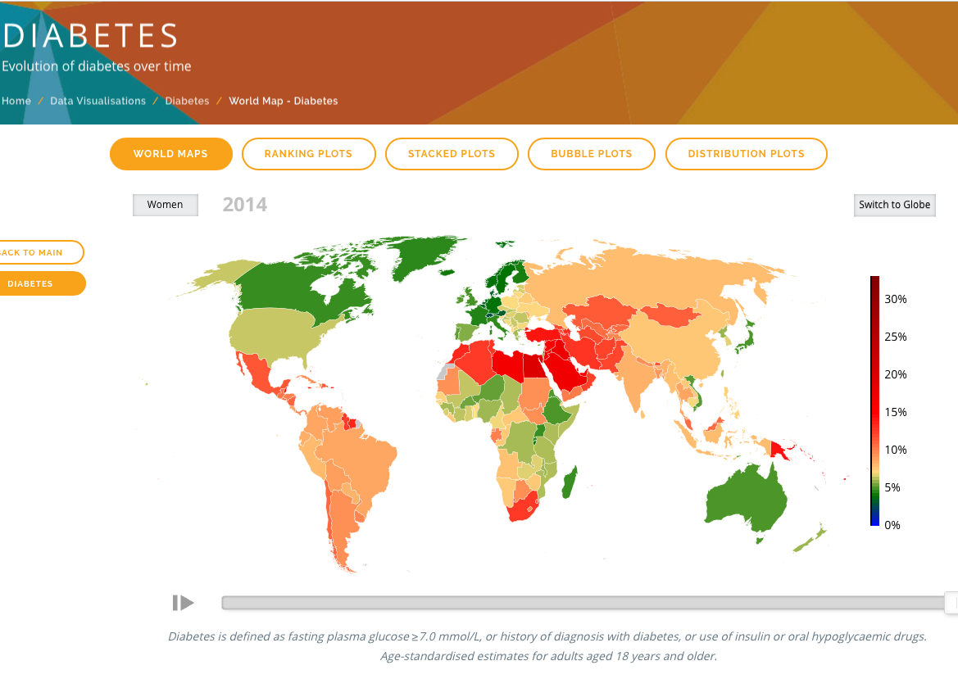
Global HIV and Diabetes Epidemiology
HIV
Diabetes
36.9 million PWH
940,000 deaths due to HIV
422 million people with Diabetes
Age-adjusted prevalence
  1980: 4.7% → 2014: 8.5%
  Greatest increase in LMIC
4 million deaths
NCD Risk Factor Collaboration, WHO Diabetes, WHO Global Observatory data

Slide 8
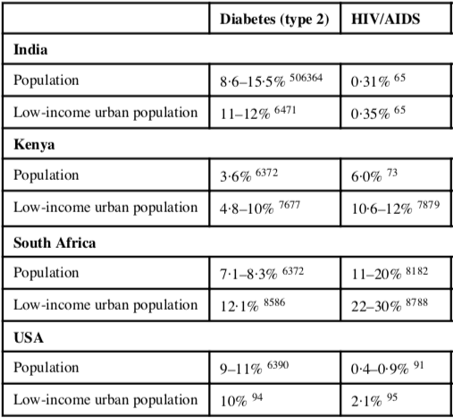
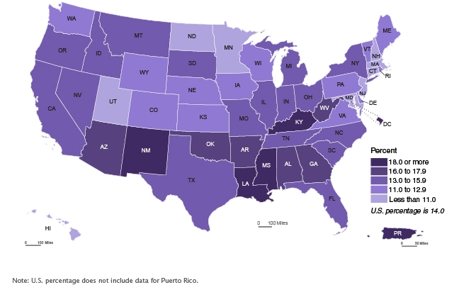
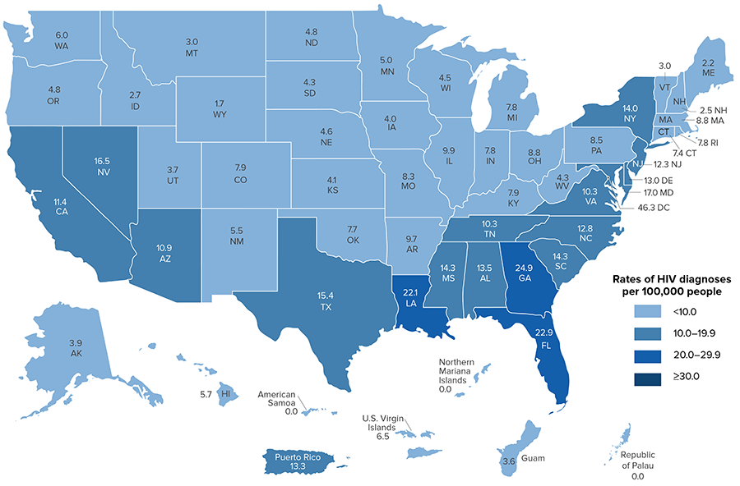
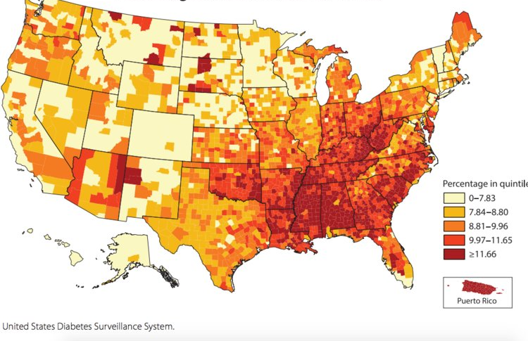
Diabetes and HIV: SDHs are a Common Bond Globally
Poverty
New HIV Diagnosis
Diabetes Prevalence
Mendenhall E et al. Lancet 2018;
US Census Bureau. Poverty 2017;
CDC HIV Surveillance 2018;
CDC Open Diab Journ 2012

Slide 9
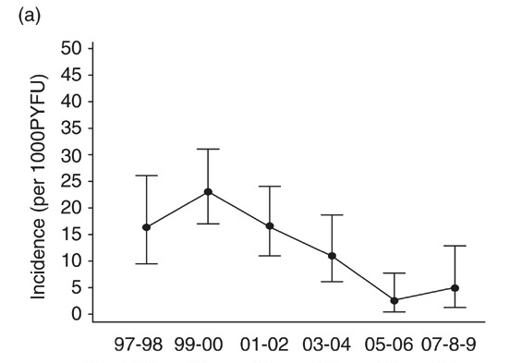
Incidence: HIV-DM
13.7ª – 17.4^{b} / 1,000 person years
  10.8 / 1,000 PY (Asia)
French Cohort: ANRS
14.1/1,000 PY
ªRichie Nansseu J et al JAIDS 2018 ^{b}Prioreschi A et al. BMJ Open 2016
Capeau, J et al. AIDS 2012
Han WM et al. JIAS 2019

Slide 10
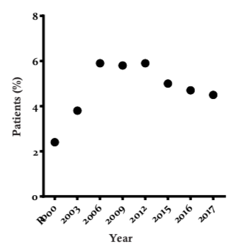
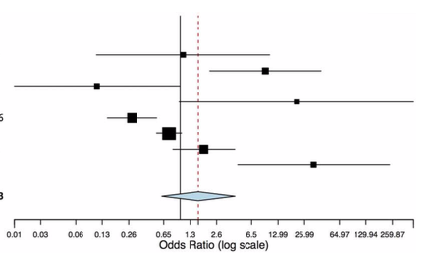
Prevalence: HIV-DM
Prevalence: MMP vs NHANES
aPR: 1.47
(1.21 to 1.78)
Sub-saharan Africa
Mexico
Kubiak R IAS 2019 TUPEB210
Hernanedez-romeiu, A BMJ Open 2017
Prioreschi A et al. BMJ Open 2016
Cano-Torres, JO Revista Medica MD 2018

Slide 11
RISK FACTORS
Traditional factors
(increasing age, minority race and obesity)
+
HIV-related factors
(chronic inflammation,
medications (D4T, ddI IDV, ), lipodystrophy, HCV infection, and immunosuppression)
=
Increased Risk
Butt et al., 2009;
Ledergerber et al., 2007;
De Wit et al., 2008
Richie Nansseu J et al JAIDS 2018

Slide 12
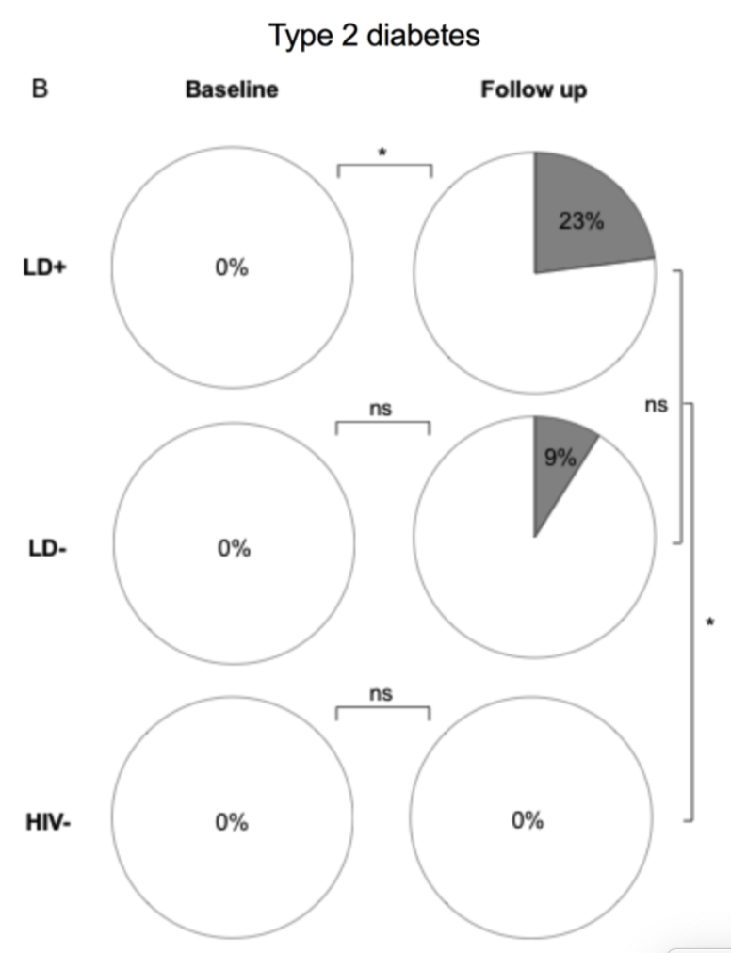
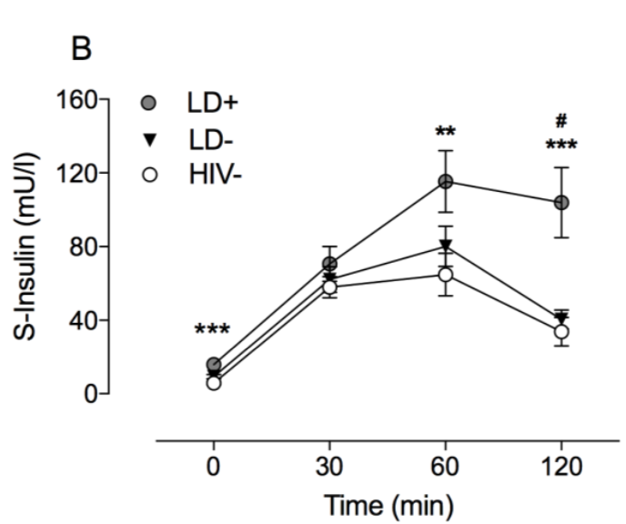
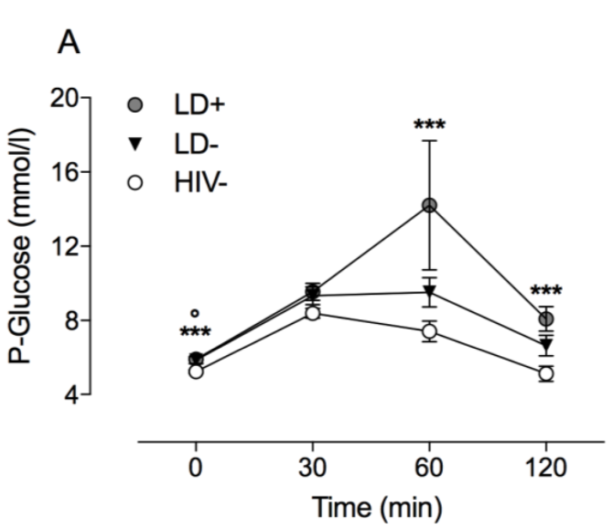
Progression to T2DM: 16-year Prospective Follow-up
HIV N=41
N=30
LD+
N=11
LD -
Control
N=28
HIV -
Lallukka-Bruck, S et al. CID 2019

Slide 13
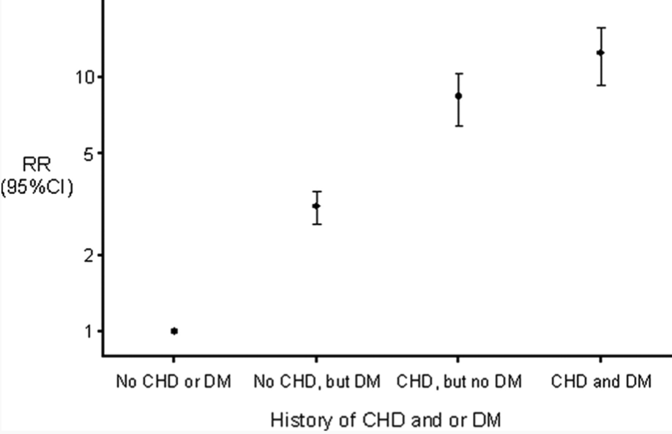
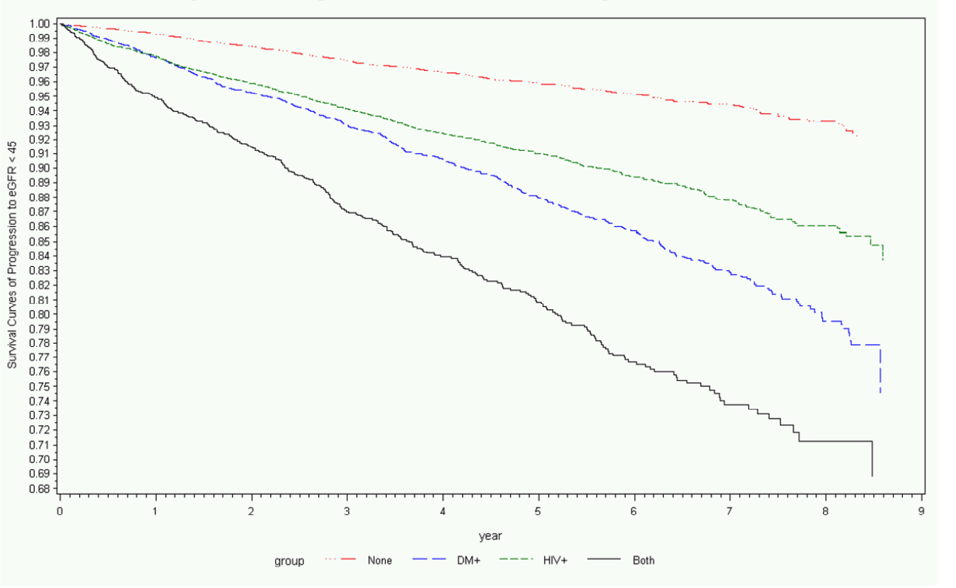
Diabetes Increases Cardio-renal Events in PWH
D:A:D: Cardiac Events
VACS: Progression of CKD
GFR < 45
None
HIV
DM
HIV+DM
HIV
DM
Mendapalli. JAIDS 2012
Worm SW. Circulation 2009

Slide 14
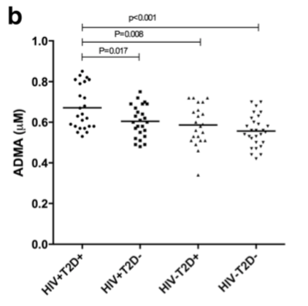
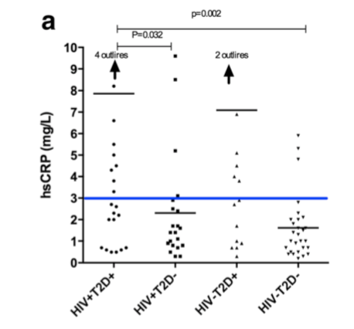
HIV-DM: Endothelial Dysfunction and Inflammation
All participants with well controlled disease states (n=100)
Primary outcome: ADMA level
  Secondary outcomes hsCRP
Inflammation
Endothelial Dysfunction
Butterfield TR. IAS 2019 TUPEB212
Hove-Skovsgaard, M BMC Inf Dis. 2017

Slide 15
Screening, Diagnosis
&
Prevention

Slide 16
Screening for Diabetes in HIV
American Diabetes Association
(not HIV specific)
HIV
Overweight or obese adults with >= 1 of following:
  1st degree relative with DM
  High risk race (AA, Latino, Native American, Asian American, pacific islander)
  History of CVD
  HTN
  HDL < 35mg/dL (0.90 mmol/L)
  TG > 250 mg/dl (2.82 mmol/L)
  Women with PCOS
  Sedentary
Prediabetes (A1c >= 5.7%[39mmol/mol], IGT, IFG) test annually
Women w/ GDM → lifelong testing at least q3 years
Otherwise, testing begins at 45 y.o.
If Normal – repeat at least q3 years
HIVMA Primary Care:
FBG or HbgA1c prior to and within 3 months of initiating ART
DHHS:
FBG or HbgA1c at baseline diagnosis, ART initiation and then annually thereafter (if normal)
ADA Guidelines 2019; Aberg et al CID 2014;
DHHS Antiretroviral Guidelines

Slide 17
Risk Scores: How do they perform in PWH?
Comparison of ADA Risk Score and Finnish Diabetes Risk Score perform (FINRISC) in women with HIV from WIHS (N=1565; 1111+, 454-)
 | HIV + | HIV - | P value
Age [yrs, median (IQR)] | 41 (34, 47) | 38 (29, 46) | <0.001
African-American race | 60% | 63% | NS
BMI [kg/m2, median (IQR)] | 27 (24, 32) | 28 (24, 34) | NS
Health Insurance | 92% | 66% | <0.001
Prediabetes | 25% | 33% | 0.003
CD4 count | 463 (300, 653) | 953 (753, 1191) | <0.0001
6% HIV + and 5% HIV- developed diabetes by 3 years
Galaviz et al. AIDS. 2018

Slide 18
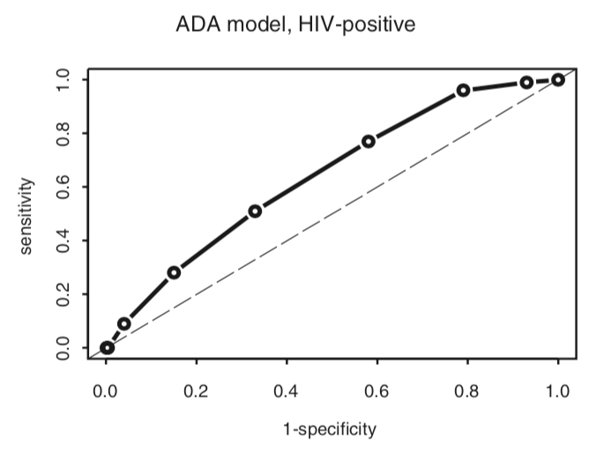
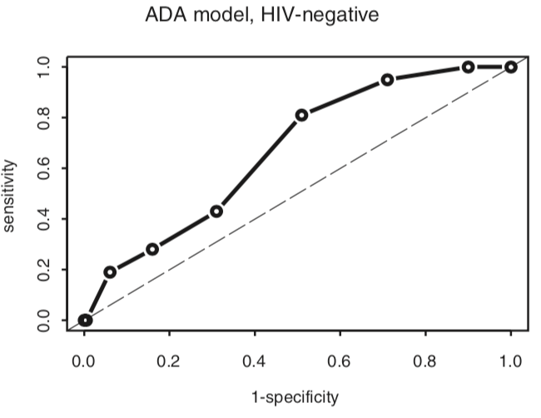
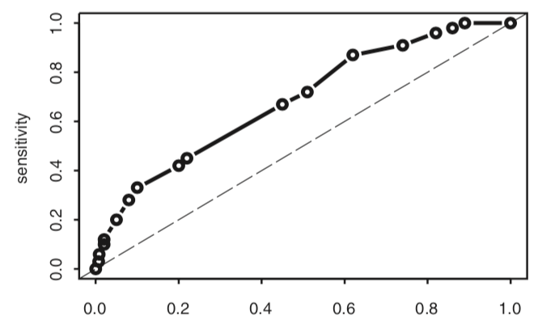
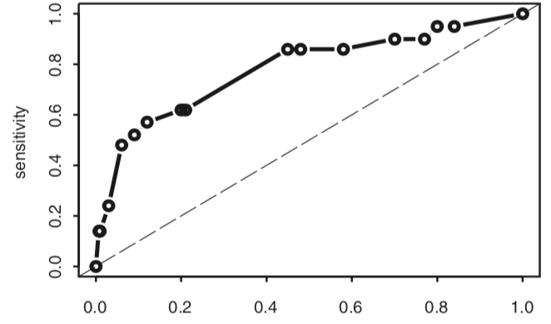
ADA: HIV-positive
ADA: HIV-negative
AUROC
0.64 (0.58-0.70)
AUROC
0.67 (0.57-0.77)
FINRISC: HIV-positive
FINRISC: HIV-negative
AUROC
0.68 (0.62-0.75)
AUROC
0.78 (0.66-0.90)
Galaviz et al. AIDS. 2018

Slide 19
Diagnosis: ADA 2019
Prediabetes
Diabetes
FBG
100 – 125mg/dL
(5.6 - 6.9mmol/L) [IFG]
A1C
5.7 – 6.4% (39-47 mmol/mol)
2-h PG 75-g OGTT:
  140 – 199mg/dL
  (7.8-11.0 mmol/L) [IFG]
FBG
>= 126mg/dL (7.0 mmol/L)
A1C
>= 6.5% (48 mmol/mol)
2-h PG 75-g OGTT
>=200mg/dL (11.1mmol/L)
Random plasma glucose
>=200mg/dL (11.1mmol/L) + symptoms

Slide 20
Factors Affecting A1c as Marker of Mean Glycemia
HIV / Antiretrovirals
Race/Ethnicity/Hemoglobinopathies
Factors affecting RBC turnover
  Sickle Cell
  Pregnancy
  G6PD Deficiency
  Hemodialysis
Iron deficiency anemia (↑ A1c relative to glycemia)
White | Hispanic | Asian | Am Indian | Black
5.78 | 5.93 | 6.00 | 6.12 | 6.18
(↓ A1c relative to glycemia)
ADA Guidelines. 2019
Herman WH et al. Diabetes Care. 2007

Slide 21
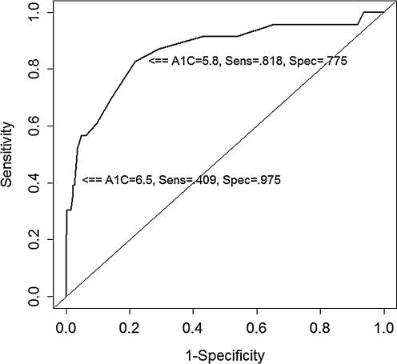

A1C in HIV
A1c underestimated glucose by 29 ± 4 mg/dL
NRTI and MCV associated with effect
  ABC drove the NRTI effect
A1c | Sensitivity | Specificity
5.8 | 82% | 77%
6.5 | 41% | 98%
Kim PS et al Diabetes Care. 2009;
Eckhardt BJ et al. AIDS Pat Car STD. 2012

Slide 22
Diabetes Prevention: Lifestyle Modifications
Single arm study: 28 patients with HIV + Impaired Fasting Glucose
Intervention: 6-month diet (DASH) and physical activity intervention
If I lose weight...the first thing they will point at, that one has got AIDS. Because of the weight you have lost.’
[ female, age 49 years].
Measure | Pre | Post | Change (%) | P value
Fasting Glucose mmol/l | 6.3 ± 0.4 | 5.8 ± 0.7 | -7.9 | 0.003
Fasting Insulin pmol/l | 100.1 ± 70.1 | 77.1 ± 61.7 | -22.7 | 0.021
Weight, kg | 88.8 ± 15.8 | 84.7 ± 15.6 | -4.6 | <0.001
SBP | 135 ± 13 | 125 ± 20 | -7.4 | 0.006
DBP | 81 ± 11 | 74 ± 10 | -8.6 | 0.006
Duncan. et al. Diabetic Medicine 2019

Slide 23
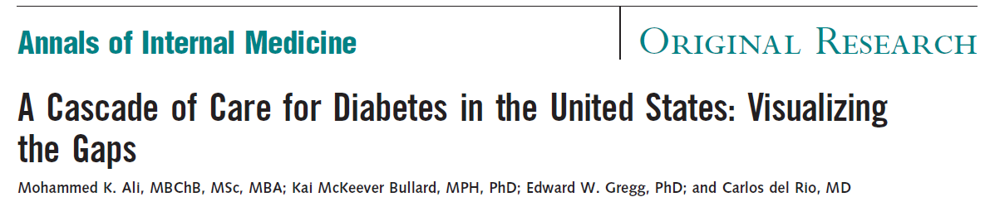
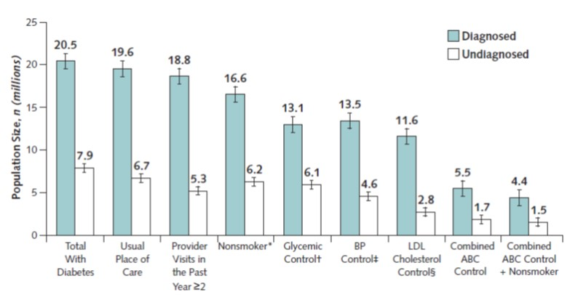
Management
&
Implementation
Ali MK. et al. Ann Int Med. 2015

Slide 24
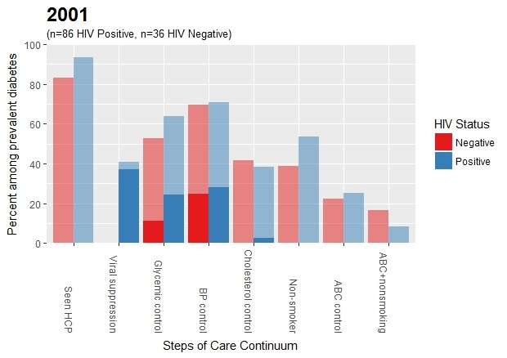
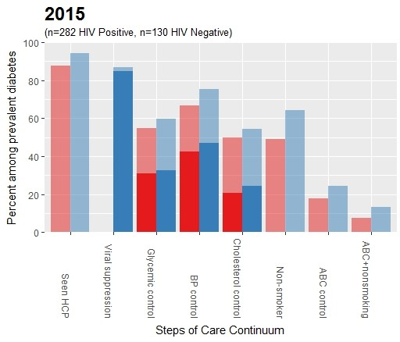
The HIV-DM Care Continuum
No Change DM Care Targets
A1c target: 61% → 58%
ABC: 23% → 22%
ABC + Non-smoker: 11% → 11%
Dramatic HIV Care Improvement
VS 40% → 85%
Colasanti J et al. OFID. 2018

Slide 25
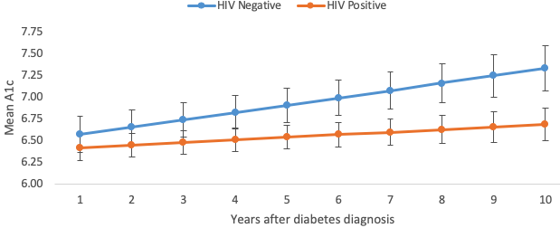
Better Control Over Time?
N=169
N=389
Women with HIV had less of increase in A1c over time compared to HIV negative (p=0.0009)
  Controlled for: age, race, weight, self-reported diabetes and diabetes medication use
Unpublished. WIHS cohort

Slide 26
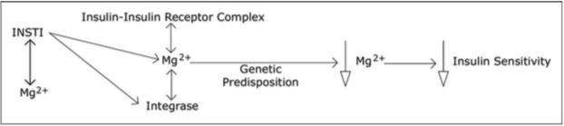
Do INSTIs Trigger Diabetes?
44 yo Asian-American with HIV, hemophilia A, HCV changed from EFV to RAL
6 Mths
A1c 9.9%
Hypoglycemia resolved & insulin stopped
10 wks
A1c 5.6%
EFV -> RAL
RAL -> EFV
- insulin
4 wks
A1c 5.5%
Symptomatic DM with BG in 400- 500s
Fong et al. Int J STD & AIDS. 2016

Slide 27
Drug-Drug Interactions: ARVs and Antihyperglycemics
Biguanides
DPP-4 Inhibitors
BIC ↑ Metformin AUC by 39%
DTG QD + Metformin 500mg BID ↑ Metformin AUC by 39% and C_{max} 66%
DTG BID + Metformin 500mg BID ↑ Metformin AUC 2.4 fold and C_{max} 2 fold
EVG/c expected to ↑ saxagliptin: limit dose to 2.5mg
All PIs may ↑ saxagliptin: limit dose to 2.5mg
EFV, NVP, ETR may ↓ saxagliptin and linagliptin levels
SGLT-2 Inhibitors
PI/r and PI/c expected to ↓ canaglifolzin level
DHHS ARV Guidelines. 2019

Slide 28
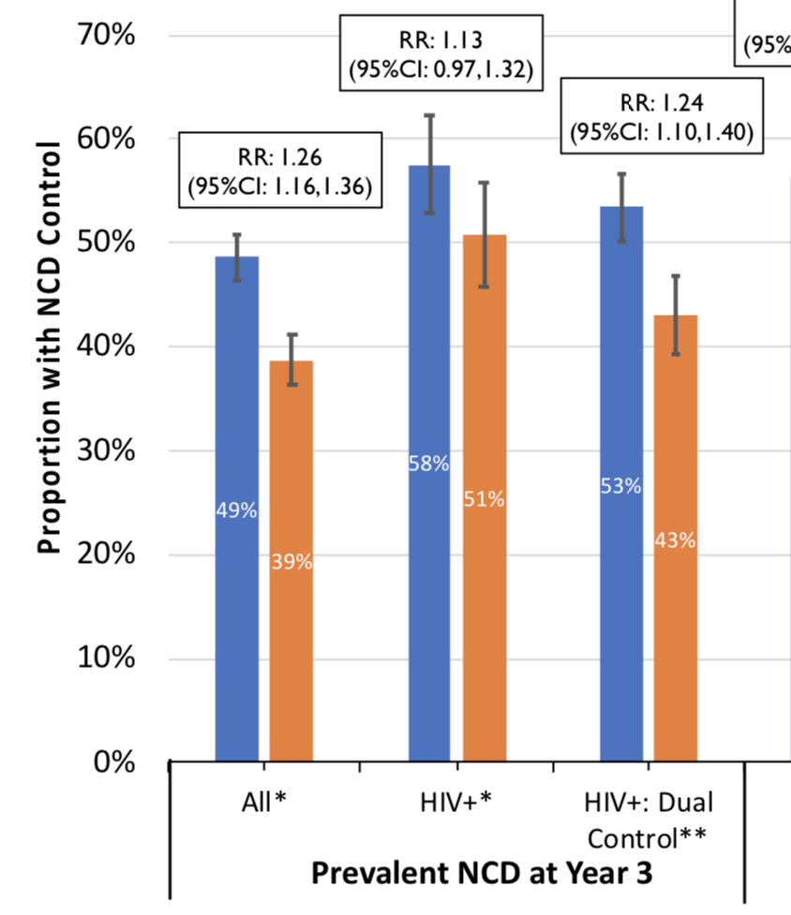
Integration of HIV and NCDs: Lessons from SEARCH
Intervention
“…The secret of the care of the patient is caring for the patient…”
- Dr. Francis Peabody
Control
Singano V et al. IAS 2019. MOPDD0105
Havlir D et al. NEJM 2019

Slide 29
Conclusions
Significant burden of disease with HIV-DM which likely contributes to increased risk of cardiovascular and renal disease
Dearth of diabetes prevention data in PWH but traditional measures may work
Traditional diabetes risk scores do not perform well in PWH
Optimal diagnostic cutoffs unknown for A1c (or pre-DM)
We have a long way to go for optimal management (think HIV 20 years ago!)

Slide 30
Acknowledgements
HIV-DM Team
Mentors
Karla Galaviz, PhD, MSc
Mohammed K. Ali, MBchB, MSc, MBA
Vincent C. Marconi, MD
KM Venkat Narayan, MD, MSc, MBA
Ighovwerha Ofotokun, MD, MSc
Brian K Agan, MD
Christina Mehta, PhD
Rincy Varughese, MS, MPH
Carlos del Rio, MD
Wendy S. Armstrong, MD

